Slide 1
Where Should we move?
Because SF is just too expensive.
A deep dive into the US Census Data by Jello World
Nicole Love, Nichole Pejoro, Ray Trounday

Slide 2
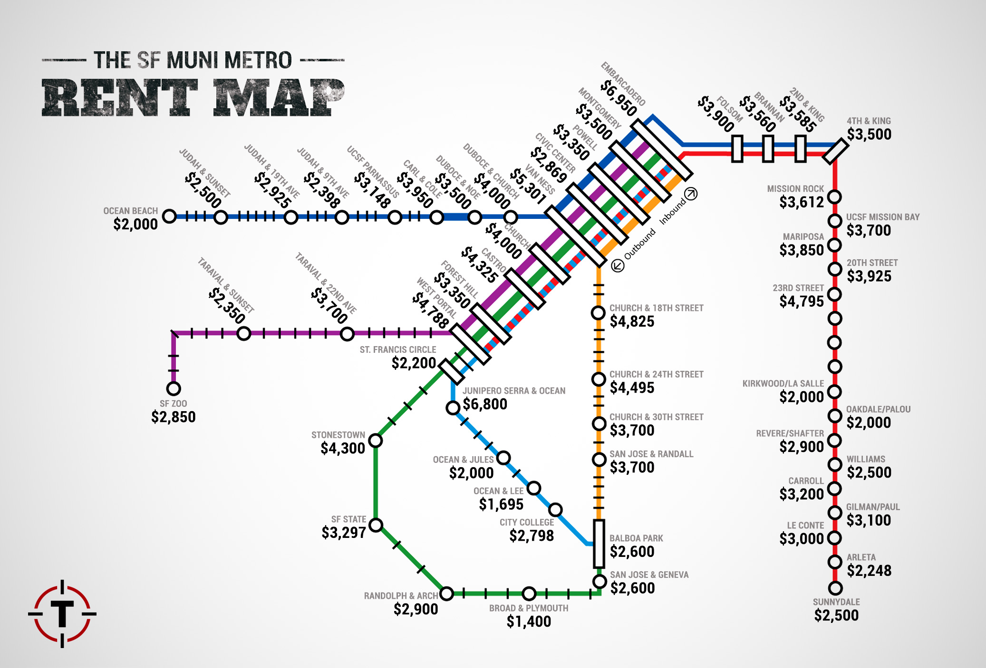
2015 Average 1 Bedroom Rent from Thrillest & Trulia

Slide 3

SF Be like…

Slide 4
Where should we go?
Our intent is to evaluate relationships between US home prices and population post-Recession and provide the top areas that are up-and-coming; potential cities of interest.
Questions to Answer
Is there a correlation between population growth and home value? Rent?
Who is moving? Median age, household income, employment status?

Slide 5
Our thoughts during this process…
We gathered US Census data from 2011-2015
We decided on these years, as the economy was in a more stable state after the Great Recession and 2015 was the most recent year available in the API.
We initially wanted to compare data with Zillow API data, however we discovered that we needed an exact address to extract data.
Fortunately, the US census had some real estate data that we could leverage.
As a team, we had different techniques and philosophies.
Difficulties with Git
Solidifying dataframe from the start
Defining scope
Notes:
Summarize where and how you found the data you used to answer these questions
Describe the data exploration and cleanup process (accompanied by your Jupyter Notebook)
Describe the analysis process (accompanied by your Jupyter Notebook)

Slide 6
Jupyter Notebook

Slide 7
Jupyter Notebook

Slide 8
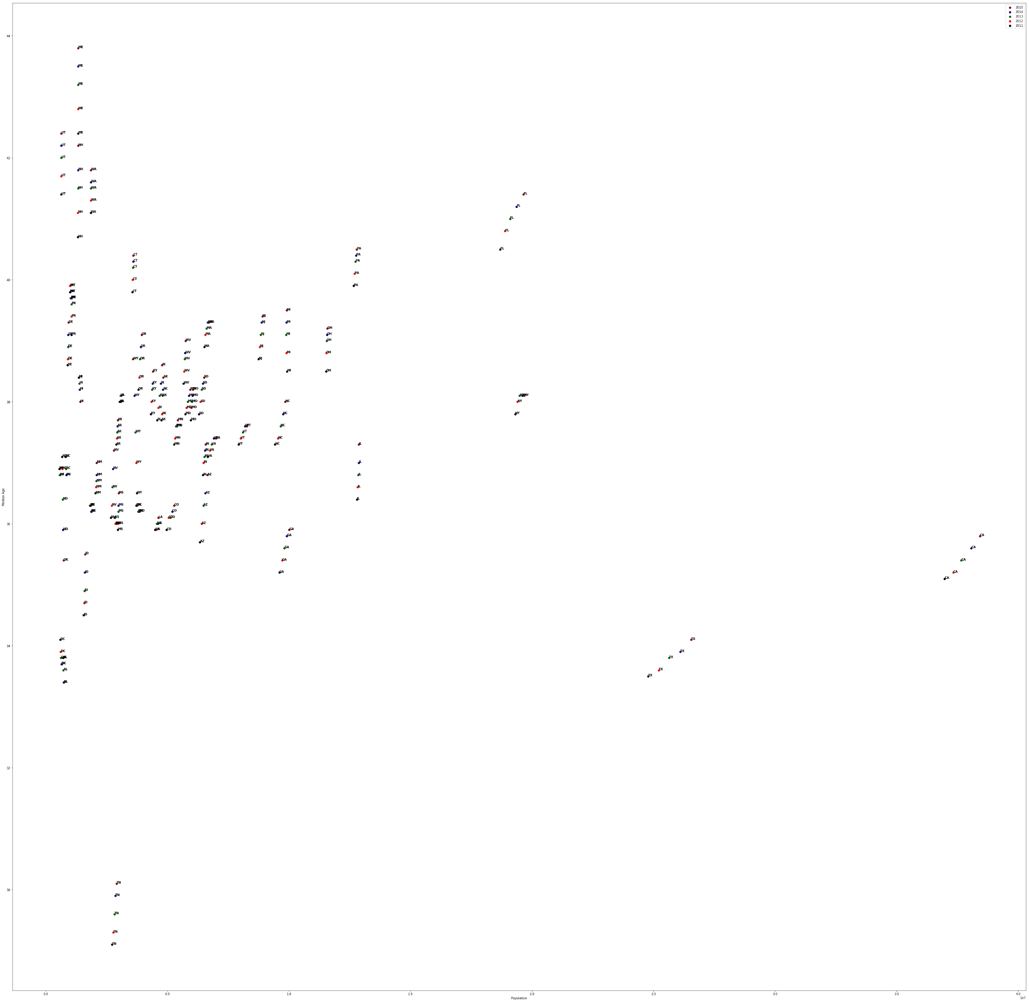
Population vs Median Age – 50 States

Slide 9
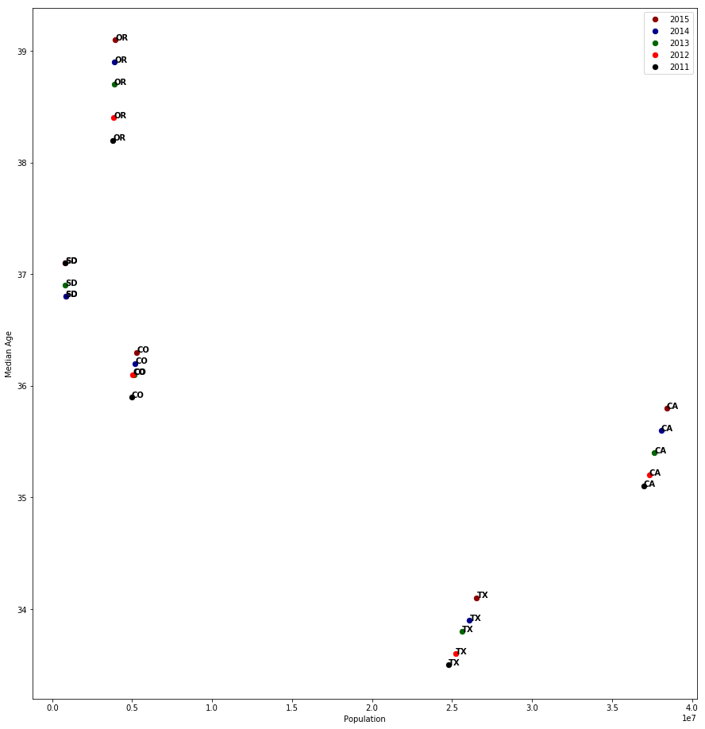
Population vs Age ( OR, SD, CO, TX and CA)

Slide 10
Analysis – Population vs Age
Texas is second only to California in Population
California, Texas and Colorado have strong YOY population growth as compared to other states in our study
South Dakota and Oregon have relatively flat population growth profile .
Georgia, North Carolina, and Vermont show significant YOY population growth
Hypothesis Strong YOY population growth are leading indicators to strong economic growth and areas families and individuals seek in a city/state they call home.

Slide 11
Unemployment Rate by Year
All 5 states show an increase in unemployment from 2011-2013; a decrease from 2013-2015
South Dakota has the lowest unemployment year after year

Slide 12
Median Rent By year
South Dakota also has the lowest median rent year after year
California is still way too expensive
Therefore…

Slide 14
Household Income by Year
South Dakota has the lowest household income
California has a slight dip in growth
Texas shows a steady increase over the 5 years

Slide 15
Home value by Year
California is the most variable
Colorado and Oregon have inverse trends
Texas has the lowest home value
Conclusion...

Slide 16
Conclusion

Slide 17
Thanks!
Jello Shots!
Q&A with Jello World

